Slide 1
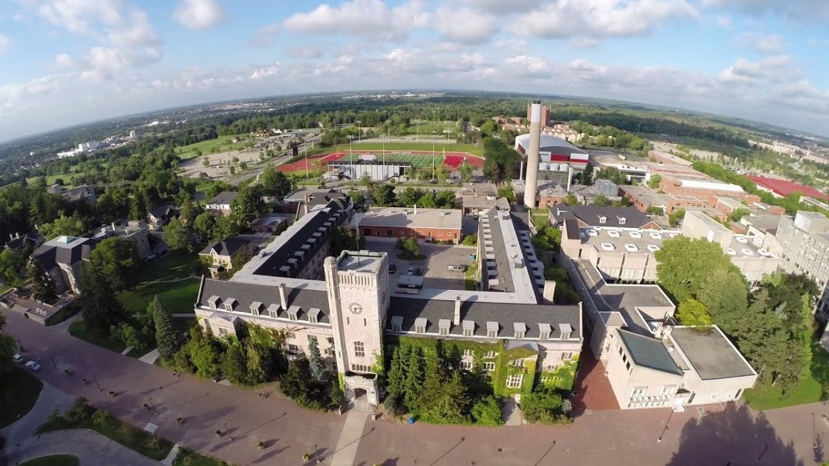
Presenter: Zhengxiao Sun, Huiming Zhou

Slide 2
Overview:
Problem Statement
Data Source
Details
Shiny App
Timeline
Q&A

Slide 3
Problem Statement
Increasingly grim employment situation
Wisely choices before starting career
Effectively analysis for the job market

Slide 4


Data Sources
Statistics Canada
Provide detailed education and employment related data, including graduate employment rate, industry distribution, salary level, etc.
Government of Canada - Education
It covers the employment trend and salary of college graduates and has high credibility of government certification.
Wikipedia & R packages
Provides a comprehensive list of colleges and universities, including the school name, province, tidygeocoder and so on.

Slide 5
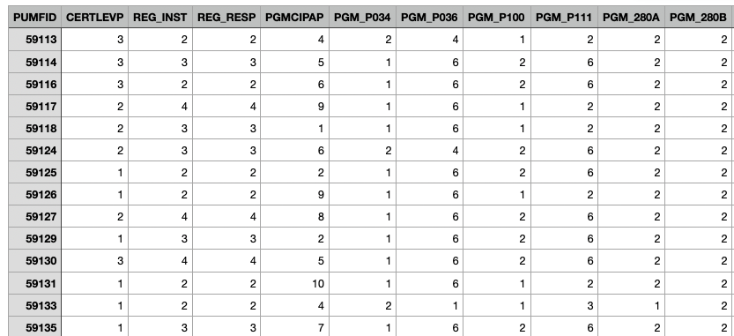
National Graduates Survey 2020
Conducted every 5 years, covering the class of 2020.
Data collection period: April 03, 2023, to August 13, 2023.
Collection methods: An electronic questionnaire followed by telephone interviews for non-responses.
16138 Rows * 116 Features
Link to the survey

Slide 6
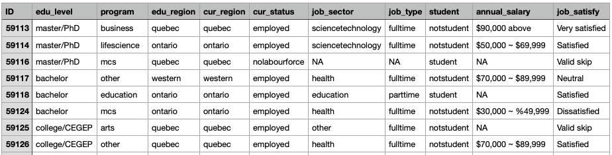
Data Categories:
10 Features (not include ID)
Education Level, Program
Region (Atlantic, Quebec, Ontario, Western)
Current Status
Job Type (North American Industry Classification System (NAICS) 2022)
Job Salary
…

Slide 7
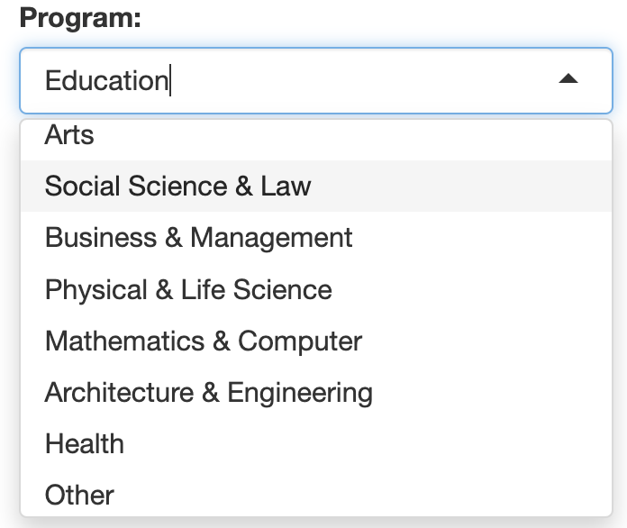
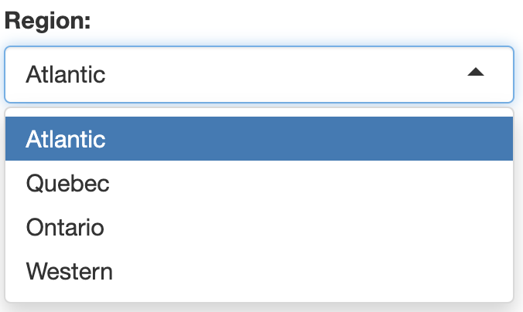
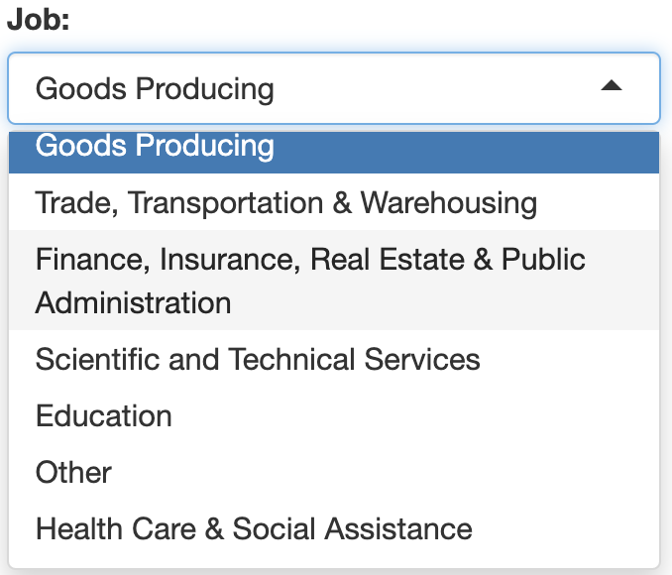
Shiny App Features:
Employment rate by education level, program, region, and job category
Employment Distribution by education level, program, region and job category
Average salary by education level, program, region, and job category
Job satisfaction by education level, program, region, and job category

Slide 8
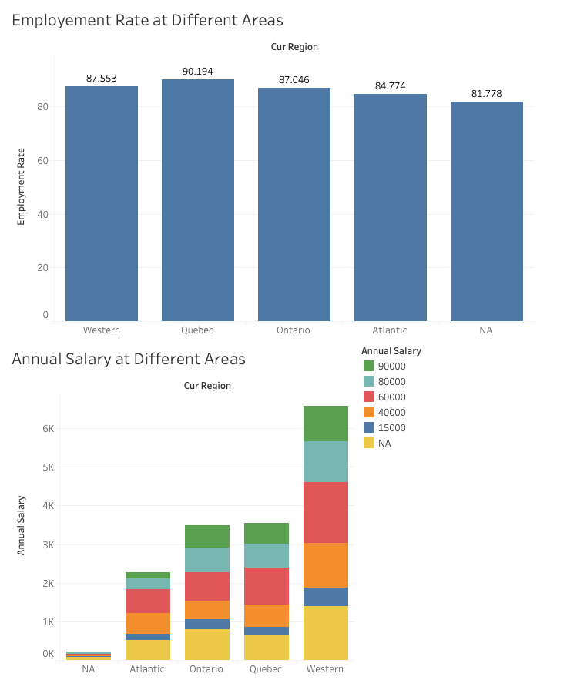
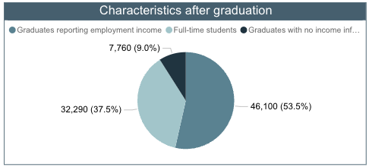
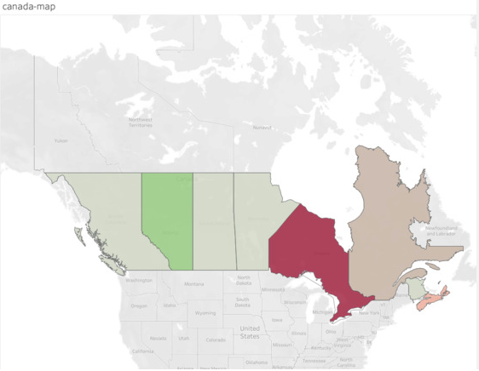

Slide 9
Potential Sections:
Distribution by universities
Include past datasets
Timeline:
Data Preprocessing
Deploy on Shiny
Final Submission
Present
11/30
12/10
12/12

Slide 10
Thanks !
Q&A
References:
https://crippledscholar.com/2020/05/30/statistics-canada-isnt-collecting-information-on-disability-during-the-pandemic/
https://brocku.ca/brock-news/2015/04/association-of-colleges-and-universities-of-canada-changes-name-logo/
https://www150.statcan.gc.ca/n1/pub/81m0011x/81m0011x2019001-eng.htm
https://www150.statcan.gc.ca/n1/pub/71-607-x/71-607-x2019031-eng.htm

